Slide 1
An introduction to information technology in libraries
Historical, current and future viewpoints in Israel and the world
(written in Hebrew by Elhanan Adler, translated to English by Yoel Kortick)

Slide 2
The first period
(Distant past, the 60's abroad, the 70's and 80's in Israel)
Computerized automated separate systems (circulation, acquisition, cataloging)
Computerized automated systems for librarians, not for the end user
Cataloging as "a smart word processer" for creating the catalog and an online catalog
The MARC Machine Readable cataloging standard for the transfer of bibliographic information (1966)
A fixed and continuous export of records in MARC format by the Library of Congress (1968)
The establishment of OCLC (1967) "Ohio College Library Center” and later “Online Computer Library Center”

Slide 3
And in Israel two leading institutions:
The National and University Library
University of Haifa

Slide 4
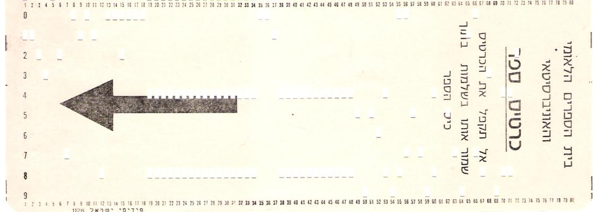
Automated computerized circulation via punch cards
(National and University Library, 1972)

Slide 5
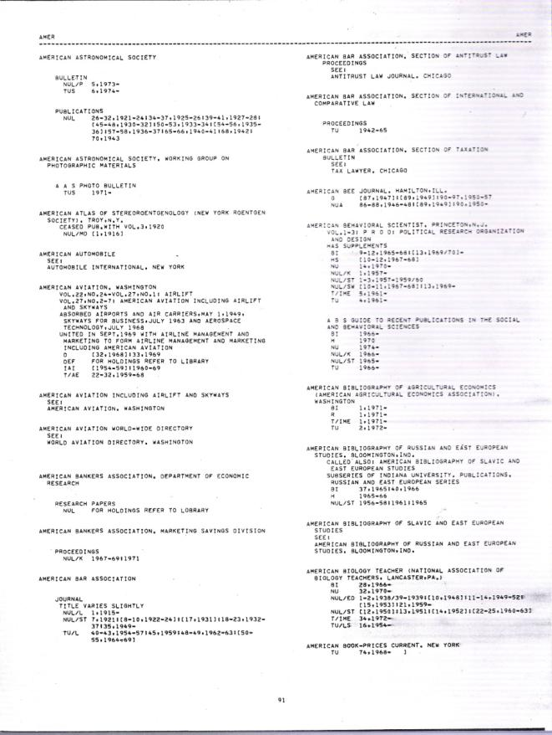
Computerized creation of a union catalog for serials (ULS) (1975)

Slide 6
And at Haifa University
The creation of the Index of Hebrew Periodicals (IHP) (1977)
Computerized automated circulation (1980)
Software for entering cataloging information (ORICAT) and the creation of cataloging cards (1981). Used by the Technion, Bar Ilan and Ben Gurion universities.
Management of the MARC database and retrieval of cataloging records (a project which was transferred from Rafael)
The HOBITS software for the management of bibliographic databases (Haifa Online Bibliographic Text System)

Slide 7
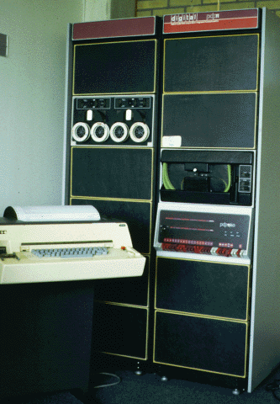
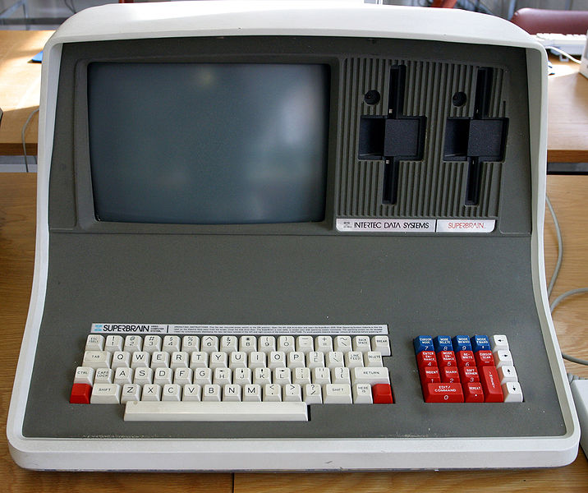
The “Mini” PDP 11/40 computer
The Micro Computer “Superbrain”

Slide 8
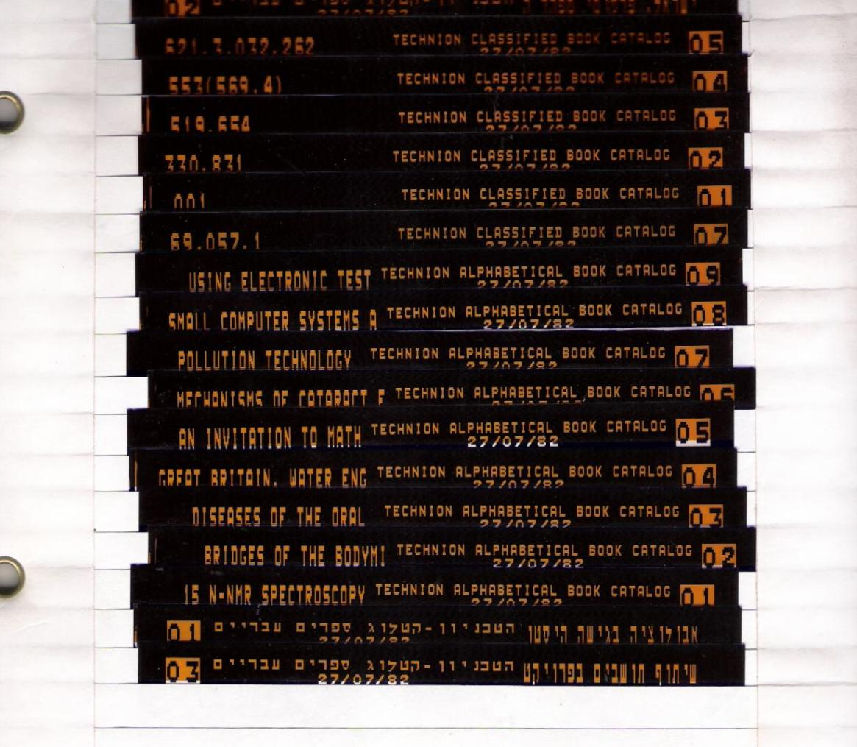
The Technion Catalog on microfiche () 1982 (דפי זיעורcreated by U. of Haifa)

Slide 9
The second period (The 80’s)
The period of the ILS and the OPAC
The combining of several library functions into one system: Integrated Library System
OPAC Online Public Access Catalog
Local development by leading Universities or by networks
The beginning of the marketing of "ready to use" software, some of which grew out of local systems (VTLS, NOTIS, DOBIS, ALEPH)

Slide 10
The history of Aleph
Automated Library Expandable Program Hebrew University
Aleph version 1 – a central system on one central computer CDC
Aleph version 2 – a decentralized system on a mini computer with VMS operating system
Aleph 300 - An advanced version of Aleph 2. VMS and Unix operating system. Developed and marketed for the European market.
Aleph 500 - An innovative and new system using Unix and Oracle. Developed and marketed for the American market.

Slide 11
The report of the of the committee for a central bibliographic database (1978). E. Adler, Y. Yoel, D. Simon, Y Schweika)
(Under the auspices of the committee for budget planning of the higher education council)
1. The creation of a National Bibliographic Catalog
Members of the council see this as important for the use and sharing of by the University Libraries. This will be established *outside* (stressed in the original) of the existing universities and will be functionally independent. Ata a later stage the universities will be able to utilize the services of this catalog.
2. All university libraries will be connected to this central catalog via terminals using telephone lines.
....
4. The catalog needs to be based on MARC, and immediately there needs to be the creation of a Hebrew MARC
....
6. The members of the committee recommend the creation of an in depth report on the need of the catalog and how it will be applied.

Slide 12
1980 – 1982 The choosing of a National System
Survey done by IBM (1980)
Recommendation: The development of Aleph instead of purchasing DOBIS/LIBIS from IBM (1981)
Both of them: A Central system - One large central computer and on central bibliographic catalog
Alternative suggestion from the University of Haifa: progress in small steps with local smaller systems.
The official committee for budget planning decided to go with Aleph, to support the development and encourage additional institutions to cooperate.

Slide 13
Aleph – from Central to Separated
No agreed-upon decision regarding a single bibliographic database (even within the Hebrew University itself)
A country wide communications network which was not reliable. (difficulties in testing between the Technion and Ben Gurion University)
If in any case there will be separate bibliographic databases - why not separate the hardware and solve the problem of communications?
Aleph 2 - an independent system for each institution (or part of institution - Hebrew University had separate computers for each campus)
Encouraging the adoption of Aleph 2 by the committee for budget and planning - supporting the purchasing of hardware.

Slide 14
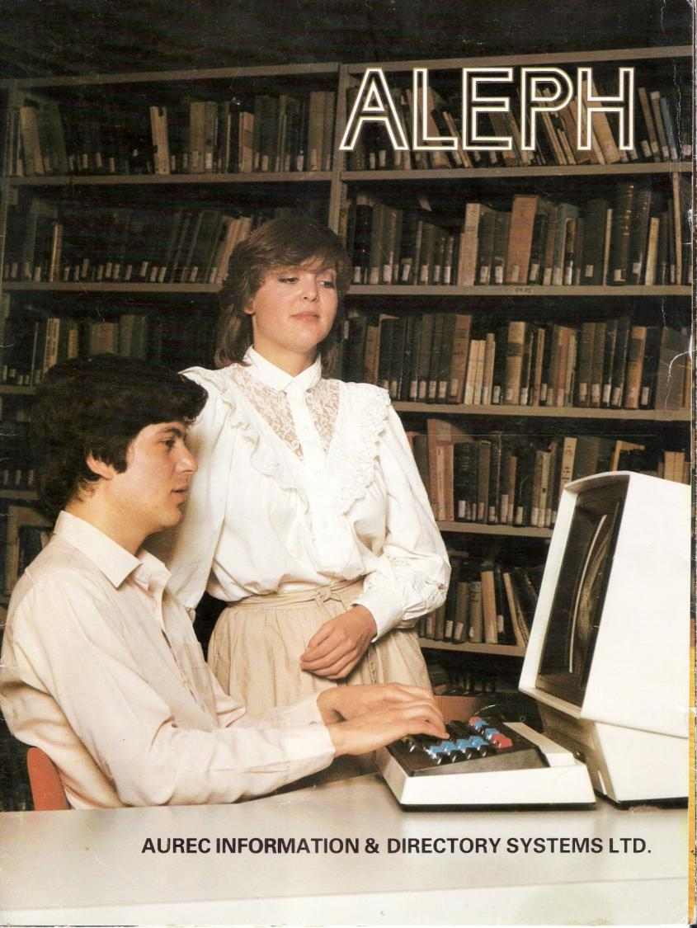
The beginning of Aleph
Advertisement from the early 80’s (marketed abroad by AUREC)
Terminal in picture: Elbit systems

Slide 15
The original sin
The creation of unique local codes for cataloging
Not using international MARC standards
Too much allowing for local standards and configurations in the system
The encouragement of “being creative” and “doing local practices”
Lost a chance to establish a national bibliographic standard.
A large part of the current issues are the results of the general atmosphere of those “early years”.

Slide 16
From Aleph 2 to Aleph 300
A problematic conversion / migration (especially for serials)
Much of the development was abroad (Denmark)
Partial and not “really” supporting MARC format
Most of the libraries converted to MARC during Aleph 300 and did so as part of the conversion process of Malmad. This allowed to cover the gaps in different ways libraries work and establish some uniformity (though there still existed local “creative” workflows).

Slide 17
From Aleph 300 to Aleph 500
A completely different system
Worked on UNIX and not VMS
Database using SQL and ORACLE
Uses Unicode instead of ASCII
Client server architecture
OPAC is web based
Not all Israeli institutions succeeded in reaching the same technical level as they did with Aleph 300.

Slide 18
The logical solution
The combining of resources for the betterment of the libraries
There are numerous examples abroad of consortia using Aleph for several institutions (with different models)
There is an unwillingness of the Universities to use Aleph within a consortium
The colleges made a correct decision to go with a consortium. Even if there are other issues it is still the right decision.

Slide 19
What now
Public interfaces which bring together data from several different sources. For example: Primo, Aquabrowser, WorldCat Local
Back office systems which are more innovative and relevant for the current and future information world
Basing catalogs on shared bibliographic databases
SAAS and Cloud computing
Interesting development - OCLC entering the area of local ILS systems
Returning to the ideas of a central system from 30-40 years ago!

Slide 20
And small and midsize libraries in Israel
From 1983 on there were local systems based on a PC (DOS and then later Windows)
Originally designed for the librarian and then later for the end user.
Web versions
Central systems today: Sapir, TOP, Sifrat, Agron, Alei Kotarim and more
A trend towards hosted systems

